Slide 1
Maze Project
Presented by, Jin Qian,19602
Guided by Dr. Chang, Henry

Slide 2
Overview
Introduction
What is Bellman Ford’s Algorithm?
What is Dijkstra’s Algorithm?
How to compare?
Maze
Bellman Ford’s Algorithm
Dijkstra’s Algorithm
Comparing
BigO
Table
Conclusion
References

Slide 3
Introduction
In this project, I would like to show up the What happen the Maze in the Algorithm.
Bellman Ford’s Algorithm
Dijkstra’s Algorithm
The practical use of the algorithm is demonstrated by comparing the two methods.
BigO
Table

Slide 4
Bellman Ford’s Algorithm
Bellman Ford’s Algorithm is a one of the algorithm to find the shortest path from one point to other point.
Works by overestimating the path lengths from the starting vertex to all other vertices. It then iteratively relaxes these estimates by finding new paths that are shorter than the previously overestimated paths.
Repeating the operation, we can find the optimal solution

Slide 5
Dijkstra’s Algorithm
Dijkstra's algorithm is an designed to find the shortest paths between nodes in a graph, and later evolved to finding the shortest path between a starting node and all nodes.
Two Step:
We pick a vertex with the shortest current cost, visit it, and add it to the visited vertices set.
We update the costs of all its adjacent vertices that are not visited yet.

Slide 6
How to compare ?
Use A example of Maze.
Big-O
Time complexity
Steps

Slide 7
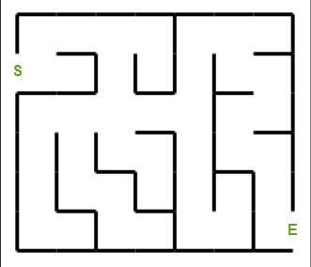
Maze
Find shortest path from S to E.

Slide 8
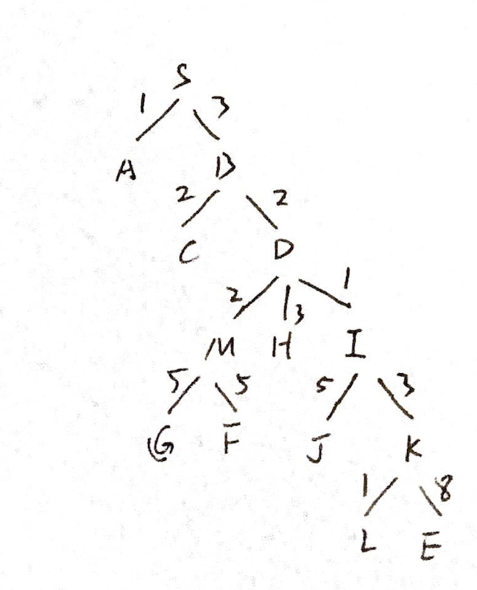
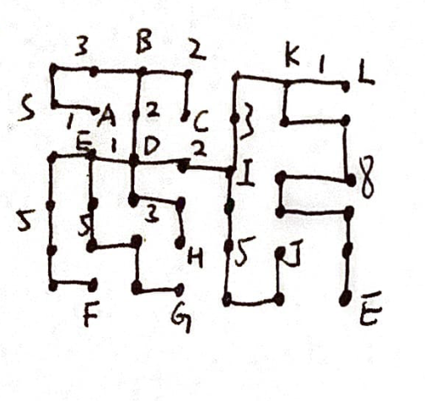
Tree of the Maze

Slide 9
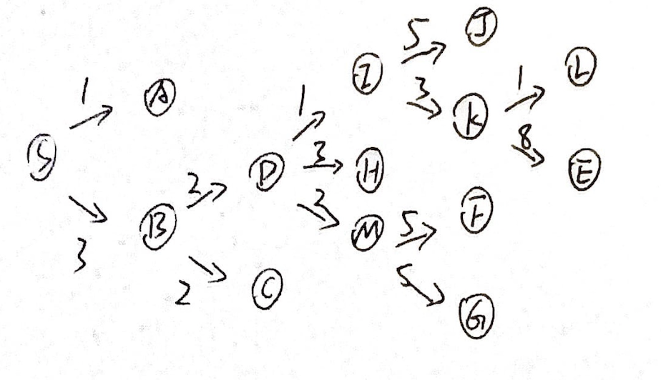
Bellman Ford’s Algorithm

Slide 10
Bellman Ford’s Algorithm
D:
0 1 3 2 2 2 ∞ ∞ 3 1 ∞ ∞ ∞ ∞
S A B C D M F G H I J K L E
3<∞ H change
1<∞ I change
M:
0 1 3 2 2 2 5 5 3 1 ∞ ∞ ∞ ∞
S A B C D M F G H I J K L E
5<∞ F change
5<∞ G change
F:
0 1 3 2 2 2 5 5 3 1 ∞ ∞ ∞ ∞
S A B C D M F G H I J K L E
no node
G:
0 1 3 2 2 2 5 5 3 1 ∞ ∞ ∞ ∞
S A B C D M F G H I J K L E
no node
cycle 1.
S:
0 1 3 ∞ ∞ ∞ ∞ ∞ ∞ ∞ ∞ ∞ ∞
S A B C D M F G H I J K L E
1<∞ A change
3<∞ B change
A:
0 1 3 ∞ ∞ ∞ ∞ ∞ ∞ ∞ ∞ ∞ ∞
S A B C D M F G H I J K L E
no node
B:
0 1 3 2 2 ∞ ∞ ∞ ∞ ∞ ∞ ∞ ∞
S A B C D M F G H I J K L E
2<∞ D change
2<∞ M change
C:
0 1 3 2 2 ∞ ∞ ∞ ∞ ∞ ∞ ∞ ∞
S A B C D M F G H I J K L E
no node

Slide 11
Bellman Ford’s Algorithm
H:
0 1 3 2 2 2 5 5 3 1 ∞ ∞ ∞ ∞
S A B C D M F G H I J K L E
no node
I:
0 1 3 2 2 2 5 5 3 1 5 3 ∞ ∞
S A B C D M F G H I J K L E
5<∞ J change
3<∞ K change
J:
0 1 3 2 2 2 5 5 3 1 5 3 ∞ ∞
S A B C D M F G H I J K L E
no node
K:
0 1 3 2 2 2 5 5 3 1 5 3 1 8
S A B C D M F G H I J K L E 1<∞ L change
8<∞ E change
L:
0 1 3 2 2 2 5 5 3 1 5 3 1 8
S A B C D M F G H I J K L E
no node
E:
0 1 3 2 2 2 5 5 3 1 5 3 1 8
S A B C D M F G H I J K L E
no node
cycle 2:
In the end answer, it is the same of cycle 1 is
0 1 3 2 2 2 5 5 3 1 5 3 1 8
S A B C D M F G H I J K L E
So the Shortest path is From S to E is
3+2+1+3+8 =17

Slide 12
Comparing
Bellman Fords algorithms Vs Dijkstras algorithms

Slide 13
Big-O
Bellman Fords algorithms:
It is more time consuming. The time complexity is O(VE).
Dijkstras algorithms:
It is less time consuming. The time complexity is O(E logV).

Slide 14
Steps
Bellman Fords algorithms:
show in the table it is 2 cycle and each cycel have 14 steps, tatal is 28 steps
Dijkstras algorithms:
It seens have 14 step in the analysis tables.

Slide 15
Conclusion
In the definnation, the Bellman Fords algorithms and the Dijkstras algorithms, both know one of the algorithm to find the shortest path from one point to other point.
In the big-O, The time complexity is Dijkstras algorithms less than Bellman Fords algorithms.
The step is also less than Bellman Ford’s algorithm,because it have more than one cycles.
But in the negative weight edge.
The Bellman Ford’s Algorithm works, it also detects the negative weight cycle.
The Dijkstras algorithms does not works.
Dijkstras algorithms: the result contains the vertices containing whole information about the network.
The Bellman Ford is contains the vertices they are connected to.

Slide 16
References
https://stackabuse.com/dijkstras-algorithm-in-python/
https://www.geeksforgeeks.org/what-are-the-differences-between-bellman-fords-and-dijkstras-algorithms/
https://npu85.npu.edu/~henry/npu/classes/algorithm/tutorialpoints_daa/slide/shortest_paths.html
https://npu85.npu.edu/~henry/npu/classes/algorithm/tutorialpoints_daa/slide/shortest_paths.html#table
https://npu85.npu.edu/~henry/npu/classes/algorithm/tutorialpoints_daa/slide/shortest_paths.html

